Slide 1
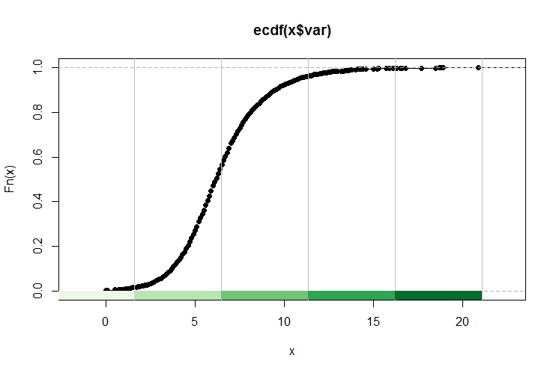
Week 10:Normality testing; Chi-square; Non-parametric tests
Geog4300: Harper
October 23, 2025

Slide 2
Today’s plan
Testing for normality
If data is not normally distributed –Wilcoxon test
If the two variables being tested are categorical rather than continuous – Chi-squared test
Introduce Lab 4

Slide 3
Dependent Variable | Independent Variable(s) | Test | Example hypotheses
Quantitative / ratio | Categorical/ nominal (2 values) | (n > 30): t-test for independent samples; | “The average speed of cars has changed between the times that speed cameras were operating and the times that they were not.”
 |  | (n < 30): Wilcoxon rank sum (non-parametric)
 | Categorical/ nominal (more than 2 values) | ANOVA | “The amount the average household gives to charity each year depends on whether the resident lives in the East, the Midwest, the South, or the West.”
Categorical | Categorical | Chi-squared test | “The typical denomination of churches depends on the state (Utah has more LDS churches, New York has more Roman Catholic churches)”
Quantitative | Quantitative (1 variable) | Correlation/ regression | “The median household income of a census tract is a good indicator of the voter turnout percentage at primary elections.”
Quantitative | Quantitative (more than one variable) | Multiple regression | “Student test scores are a function of the median income, amount spent per capita on education, and average number of years of schooling of teachers in a census tract.”

Slide 4
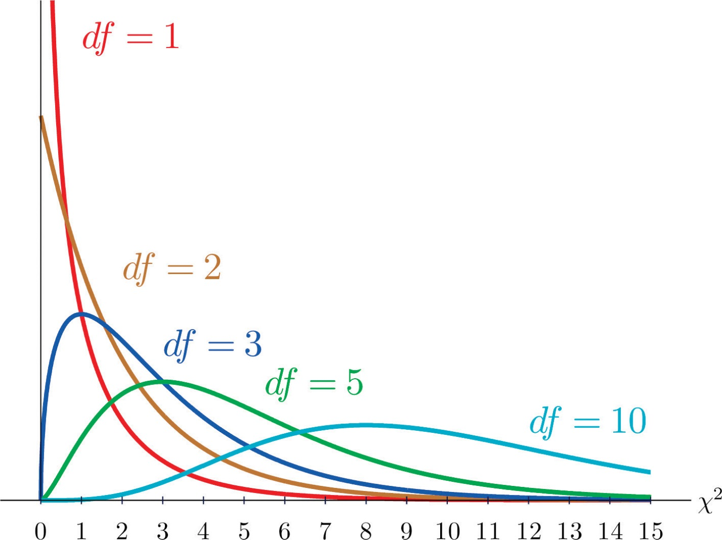
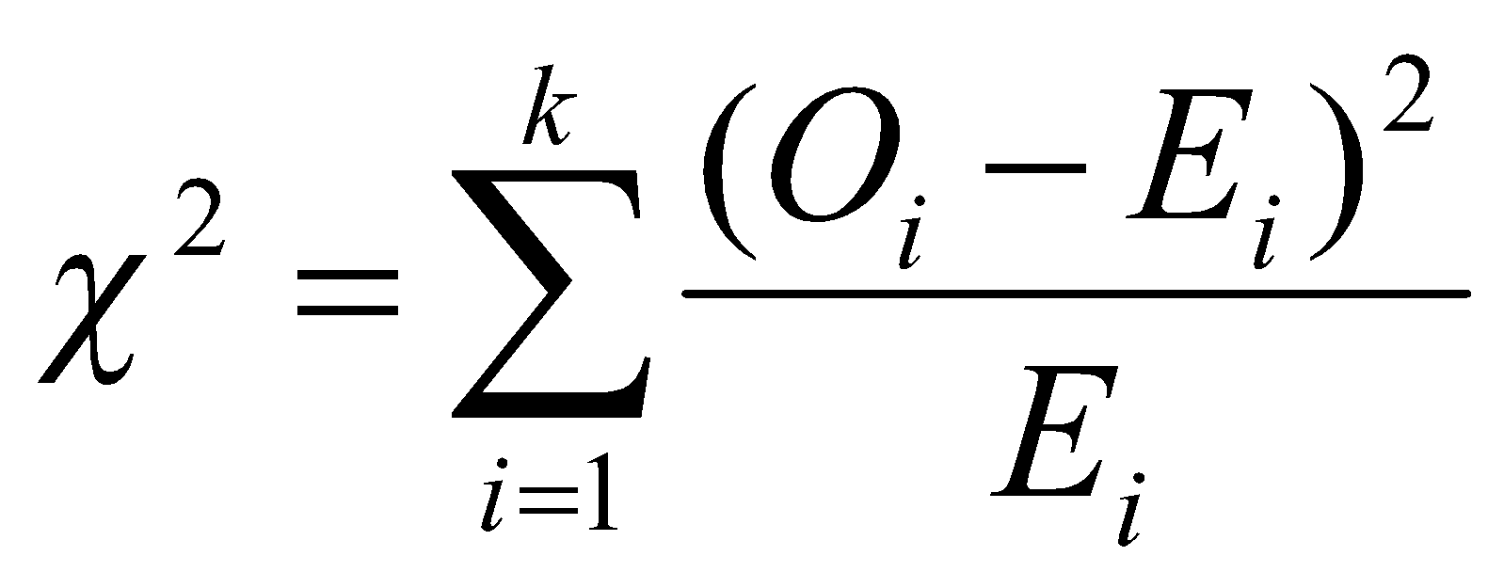
Chi-square tests
For two categorical variables
O_{i} = Observed value for observation i
E_{i} = Expected value for observation i
k = Number of observations in all groups
Notes:
T-test: independent variable vs dependent variable, work when you have a categorical variable and nominal or ratio data.

Slide 5

An example
Does your football team tell you something
about your Thanksgiving meal preference
(dark/white meat or tofurkey)?
What are the independent and dependent variable?
Independent: Football team (Nominal)
Dependent: Meal choice (Nominal)
Notes:
Alternative hypothesis is usually what you’re trying to prove.

Slide 6
ESPN surveyed 85 football fans…
 | White meat | Dark meat | Tofu-rkey | TOTAL
Lions | 15 | 25 | 3 | 43
Cowboys | 25 | 10 | 7 | 42
TOTAL | 40 | 35 | 10 | 85
This contingency table shows turkey preference as a function of (“contingent upon”) team preference.
Degrees of freedom = (#rows -1)*(#cols-1) = (2-1)(3-1) = 2
Notes:
Alternative hypothesis is usually what you’re trying to prove.

Slide 7
Calculating expected values
 | White meat | Dark meat | Tofu-rkey | TOTAL
Lions |  |  |  | 43
Cowboys |  |  |  | 42
TOTAL | 40 (47%) | 35 (41%) | 10 (12%) | 85
Notes:
Alternative hypothesis is usually what you’re trying to prove.

Slide 8
Calculating expected values
 | White meat | Dark meat | Tofu-rkey | TOTAL
Lions | =.47 * 43 = 20.2 | =.41 * 43 = 17.7 | =.12 * 43 = 5.1 | 43
Cowboys | =.47 * 42 = 19.8 | =.41 * 42 = 17.3 | =.12 * 42 = 4.9 | 42
TOTAL | 40 (47%) | 35 (41%) | 10 (12%) | 85
Notes:
Alternative hypothesis is usually what you’re trying to prove.

Slide 9
What’s the chi-square statistic?
 | White meat | Dark meat | Tofu-rkey | TOTAL
Lions | O = 15 E = 20.2 | O = 25 E = 17.7 | O = 3 E = 5.1 | 43
Cowboys | O = 25 E = 19.8 | O = 10 E = 17.3 | O = 7 E = 4.9 | 42
TOTAL | 40 (47%) | 35 (41%) | 10 (12%) | 85
χ² = (15-20.2)² / 20.2 + … (7-4.9)² / 4.9
Critical value for 2 degrees of freedom is 5.99
Notes:
Alternative hypothesis is usually what you’re trying to prove.

Slide 10
You try it!
A survey was done of Manhattan residents to see if their most common transportation method was related to their income. Here are the results:
 | Car | Transit | Walk/bike | Total
Low income | 58 | 21 | 36 | 115
Moderate income | 199 | 49 | 64 | 312
High income | 205 | 32 | 29 | 266
Total | 462 | 102 | 129 | 693
Using a chi-square test, check to see if these results show a difference between these groups. You may want to enter this table in Excel to run this analysis.
Notes:
Alternative hypothesis is usually what you’re trying to prove.

Slide 11
Writing up results
Results of statistical analysis generally focus on direction, magnitude, and significance.
For a chi-square test, calculate the percentage of each income group in each transit type. Then write a paragraph that summarizes your findings. What pattern do you see of higher or lower rates? What is the magnitude of the key differences? Is it statistically significant?
 | Car | Transit | Walk/bike | Total
Low income | 58 | 21 | 36 | 115
Moderate income | 199 | 49 | 64 | 312
High income | 205 | 32 | 29 | 266
Total | 462 | 102 | 129 | 693
Notes:
Alternative hypothesis is usually what you’re trying to prove.

Slide 12
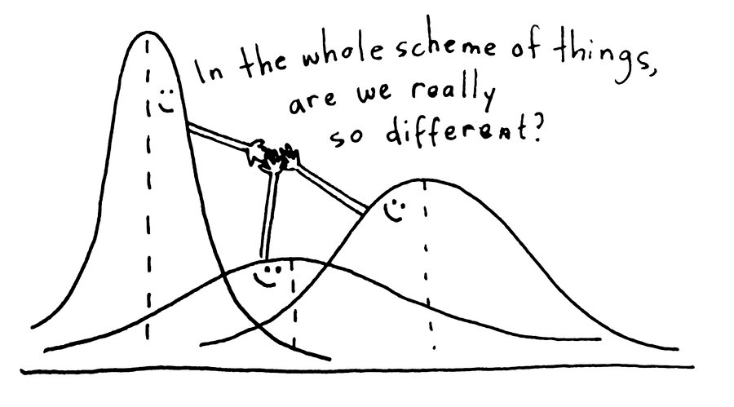
ANOVA: Analysis of Variance
Notes:
Alternative hypothesis is usually what you’re trying to prove.

Slide 13
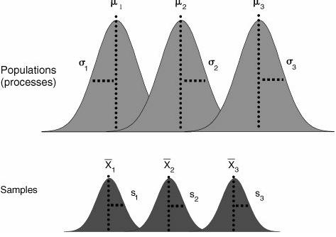
ANOVA: Analysis of Variance
Within group variance
One observation
Between group variance
Mean of ALL observations-
the “grand mean”
Notes:
Alternative hypothesis is usually what you’re trying to prove.

Slide 14
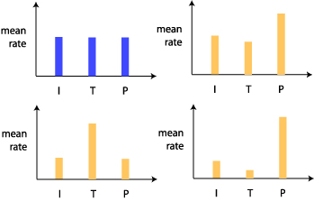
ANOVA: Analysis of Variance
The ANOVA test would be significant in finding a difference for all of these cases except for here
Notes:
Alternative hypothesis is usually what you’re trying to prove.

Slide 15
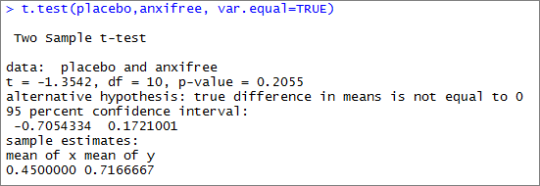
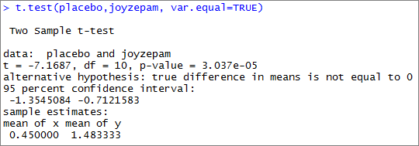
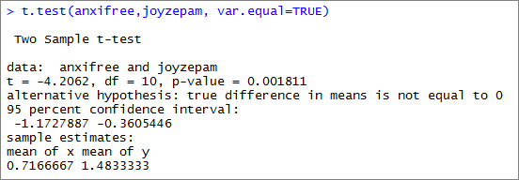
Post-hoc tests
Repeated t-tests between all groups to identify where the difference is.
Notes:
Alternative hypothesis is usually what you’re trying to prove.

Slide 16
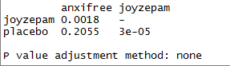
Post-hoc tests
To control for potential false positives, post hoc tests use statistical corrections.
Bonferroni correction:
Multiple the p-value by the number of tests
3 * 0.0018 = 0.0054
3 * 0.2055 = 0.6165
3 * 0.00003 = 0.00009
Notes:
Alternative hypothesis is usually what you’re trying to prove.

Slide 17
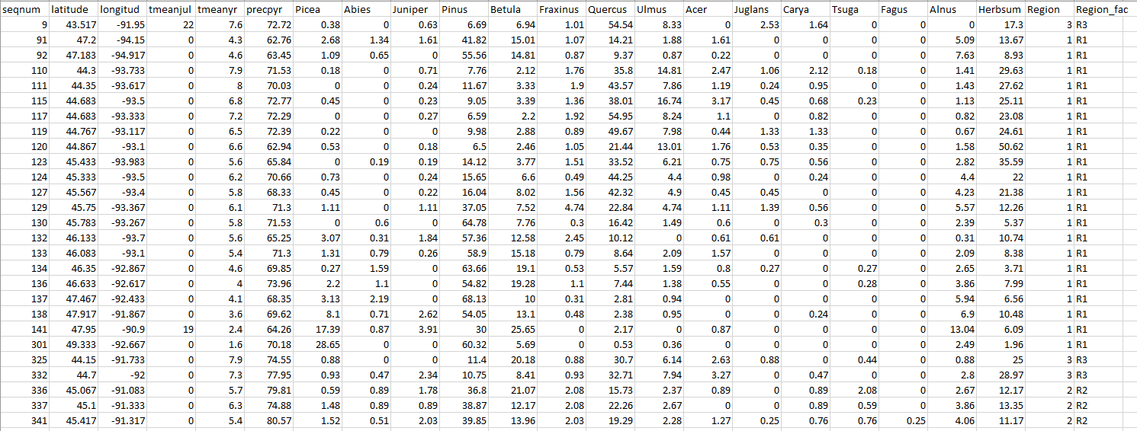
Let’s try it!
ANOVA with the Midwest pollen data in Excel.
Notes:
Alternative hypothesis is usually what you’re trying to prove.

